Slide 1

Amazon Customer Review Sentiment Analysis
By: Kamaal Bartlett

Slide 2
Summary
The purpose of this analysis is to classify customer sentiments as positive, negative, or neutral based on their reviews
To identify the polarity of unseen reviews and gain insights on product performance
To help drive business decisions

Slide 3
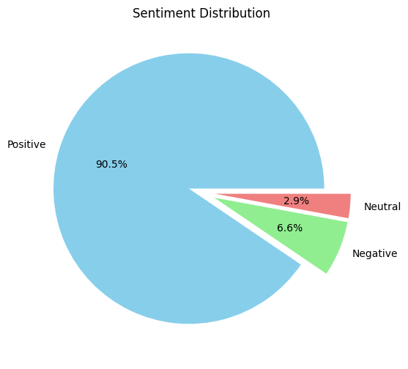
Data cleaning
Based on the pie chart we can see that about 90.5% of reviews for this product were positive, 6.6% negative and 2.9% neutral
The product looks to be successful, but the revenue attributed to the product would have to be investigated before making a confident business decision
We should perform outreach to 9.5% of the customers that reviewed this product

Slide 4
Data cleaning
This 9.5% is the sum of neutral and negative reviews
We should reach out to the negative comments to understand what was their experience and how could we make improvements
We should also reach out to the neutral reviewers to understand what they liked about the product and what was missing that stopped them from truly loving it.

Slide 5
Exploratory Data Analysis
The 10 most comments words found in positive, neutral and negative comments were found
The most frequent words were visualized in picture form and numbers represented via graphs
Notes:
After cleaning the data, statistical summaries and visualizations were made. By understanding the distribution of sentiments in the dataset, identifying any patterns or tends, and gaining valuable insights that may influence the modeling approach.

Slide 6
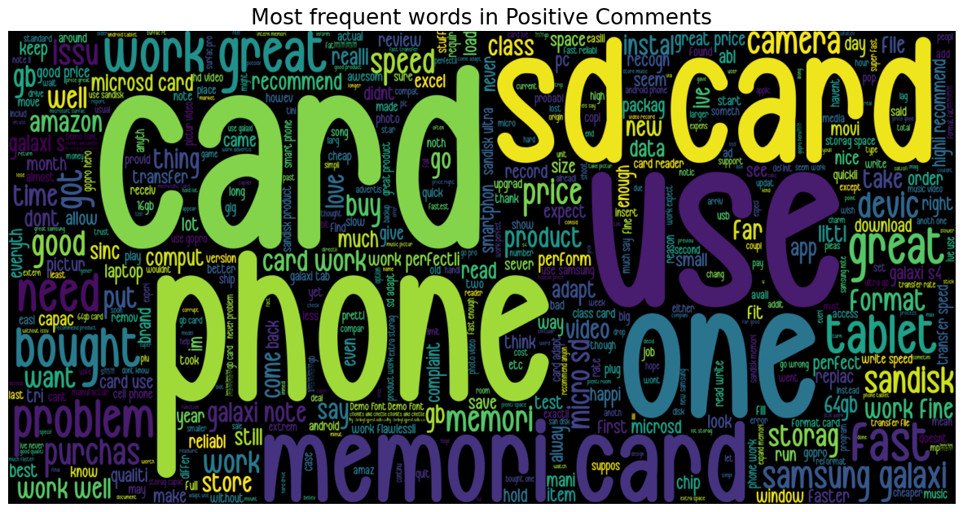
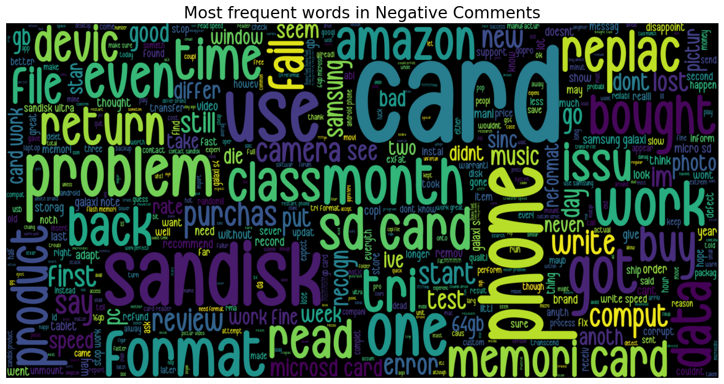
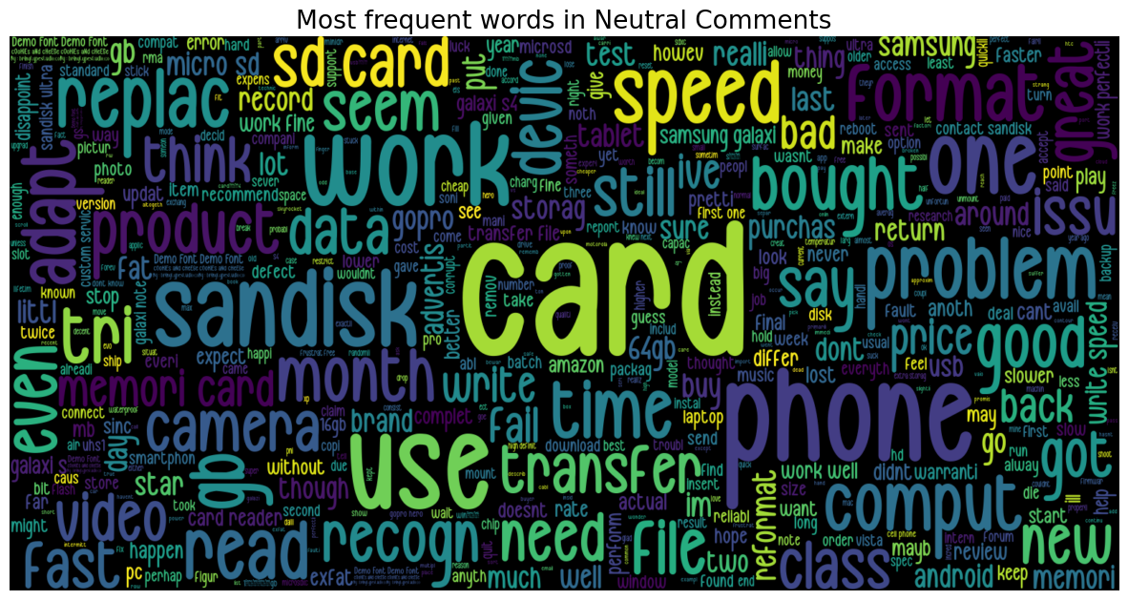
Most frequent words in reviews

Slide 7
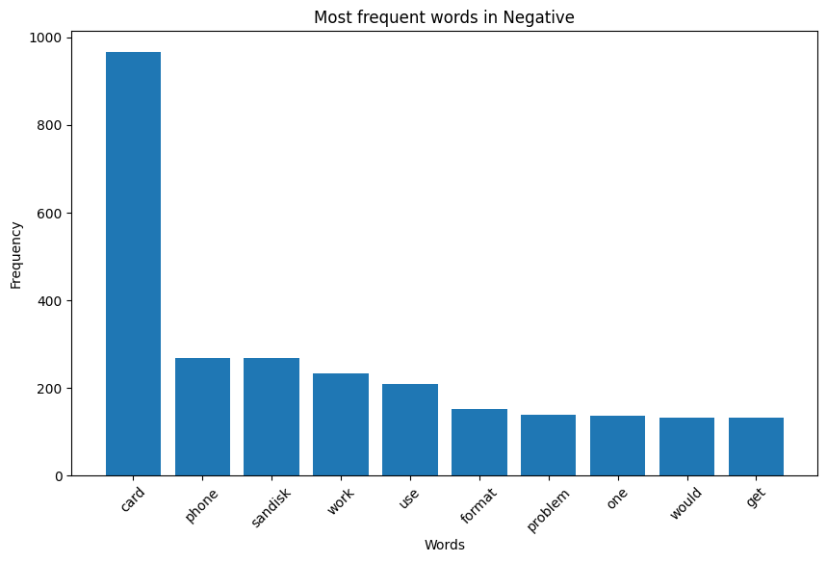
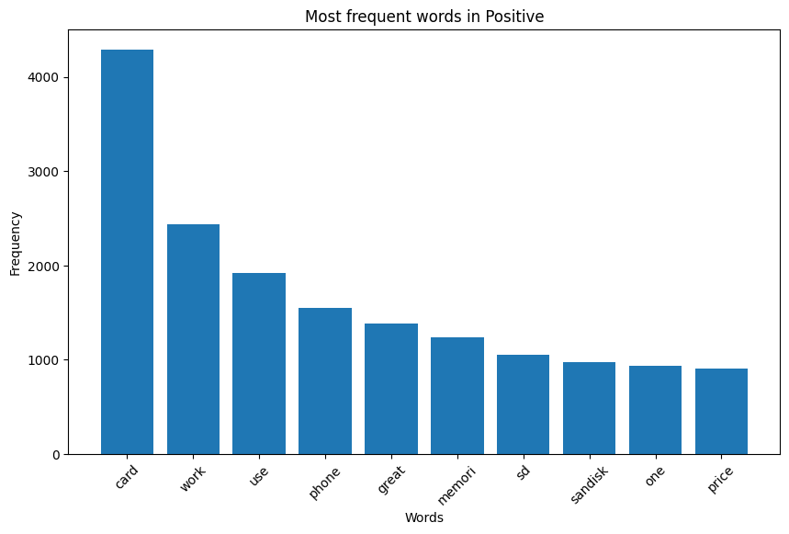
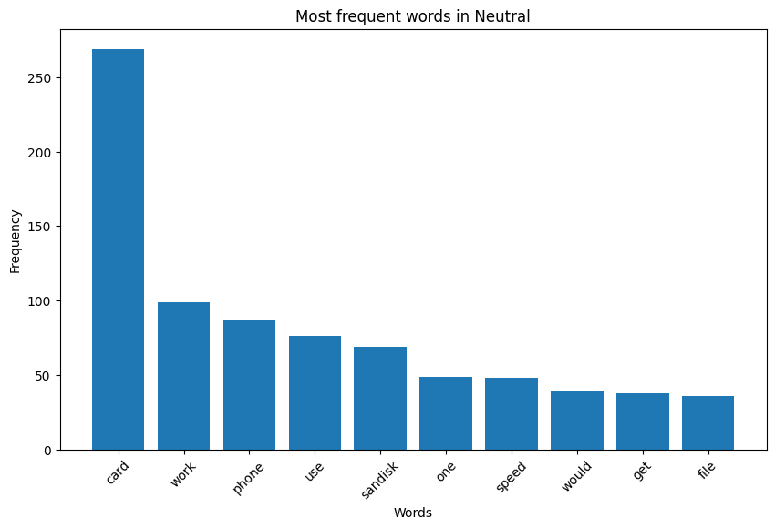
Count of top 10 words

Slide 8
Vectorization and Feature Engineering
To build predictive models, the text reviews are converted into numerical representations
Techniques such as Count Vector and TF-IDF (Term Frequency-Inverse Document Frequency) were used
The sentiment labels (positive, negative, neutral) are encoded to numeric values for classification
The model will try to match the sentiment labels to the comments based on the polarity of the words used in the comments

Slide 9
Model Selection and Training
The three models used in this analysis were Naïve Bayes, Logistic Regression and Support Vector Machines (SVM)
Each model is training on a training set and evaluated using the validation set
Performance metrics such as accuracy, precision, recall and F1 score are used to assess the model's effectiveness
For the purpose of this analysis, accuracy on the validation and test sets are going to be the key indicators

Slide 10
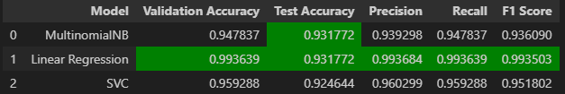
Count-Vector Performance Summary
Linear Regression performed the best in every category, making it the best model of all tested using the test data created by count-vectorization
Validation accuracy is 99% and test accuracy is 93%, the results returned from this model can be trusted

Slide 11
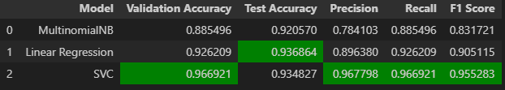
TFID Performance Summary
SVM performed the best in almost every category for TFID Vectorization
Logistic Regression had the best test accuracy at 93%

Slide 12
Recommendations
Based on the results, it is recommended to further explore the Logistic Regression model for sentiment analysis on customer reviews.
Additionally, additional features or techniques such as word embeddings or deep learning models like Recurrent Neural Networks (RNNs) can be explored to enhance the accuracy and performance of sentiment classification.

Slide 13
Limitations and Future Work
It is important to note that the accuracy and performance of the models may vary depending on the dataset and domain.
The results obtained in this analysis are specific to the provided dataset and may not generalize to other contexts.
Further experimentation and evaluation on diverse datasets are recommended to validate the findings.

Slide 14
Conclusion
In conclusion, sentiment analysis on customer reviews using machine learning models proved to be effective in classifying customer sentiments.
The Logistic Regression model for the Count-Vector method demonstrated the highest performance among the models evaluated, with the highest precision and F1 score.
These findings can assist the business in understanding customer sentiments and making informed decisions based on customer feedback

